Slide 1

When You Think of Group Records?

Slide 2
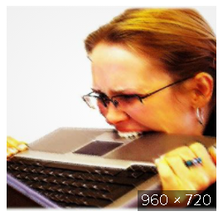
Does it evoke strong emotions?

Slide 3

Do you feel bent out of shape?

Slide 4
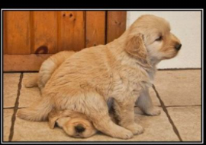
Or just plain, well……that!

Slide 5
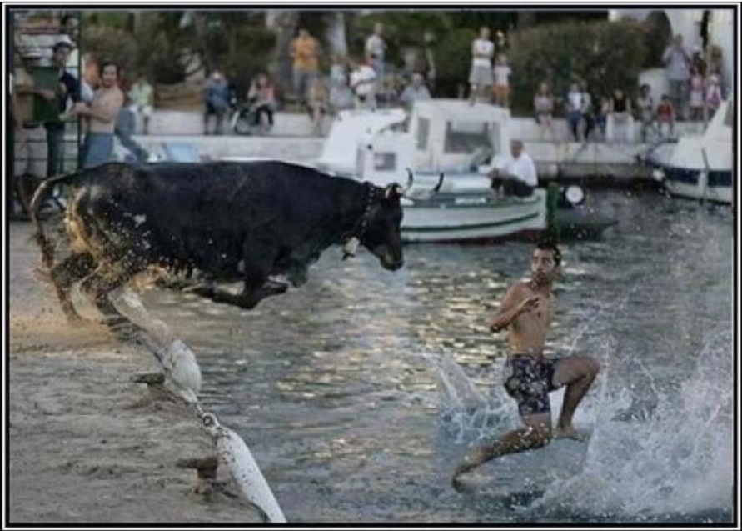
Fear Not!

Slide 6
Group Records
Short introduction to Group Records: What it can do for you!!! GATEWAY FOR NEWCOMERS!!!
The dang-blasted group records change form!!! And what the heck is a “tiny url.”
Indispensable Tips and Tricks to be a group records Ninja.
Quick introduction to resources = The Service Manual and the Group Records attachments.

Slide 7
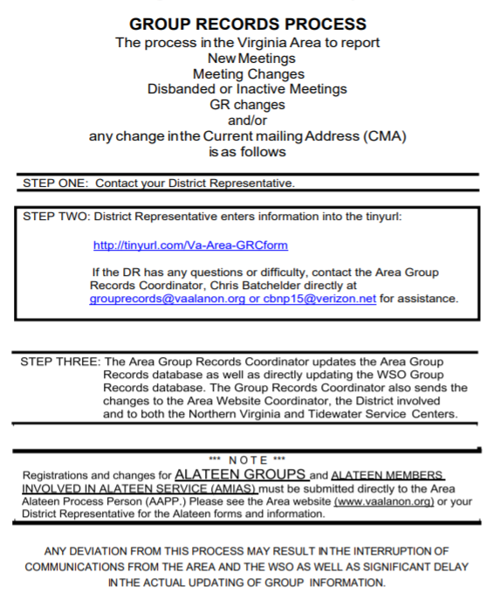


Where do I start?
Go to vaalanon.org/Area website
Click on members
Click on Assembly in drop down

Slide 8
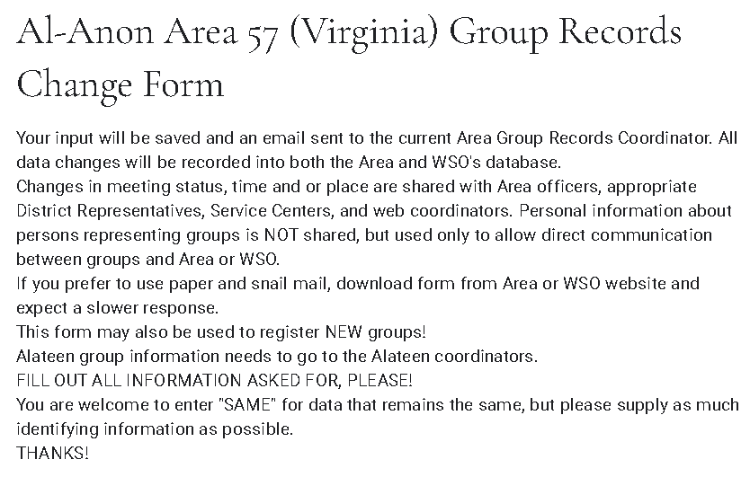
Group Records excel spreadsheet

Slide 9
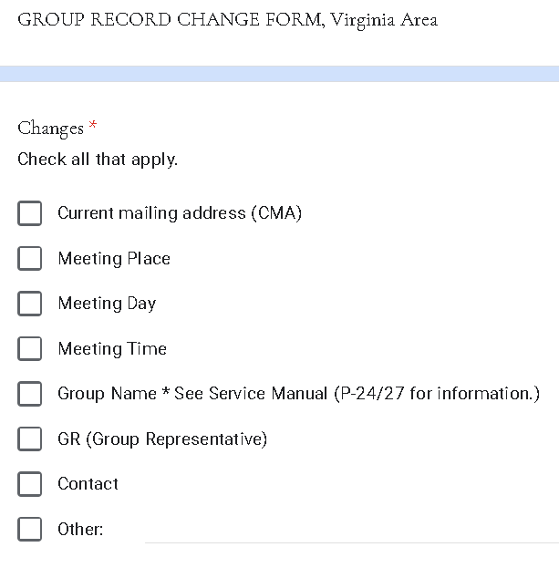

Slide 10
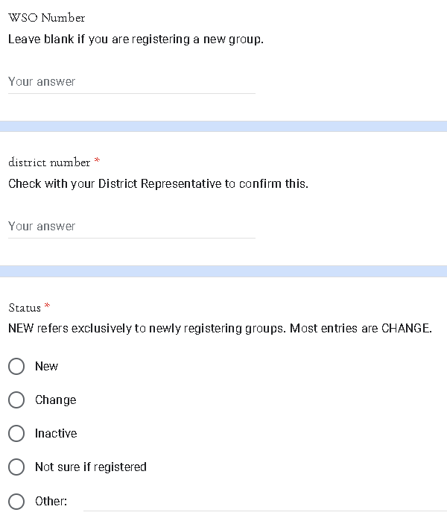

Slide 11
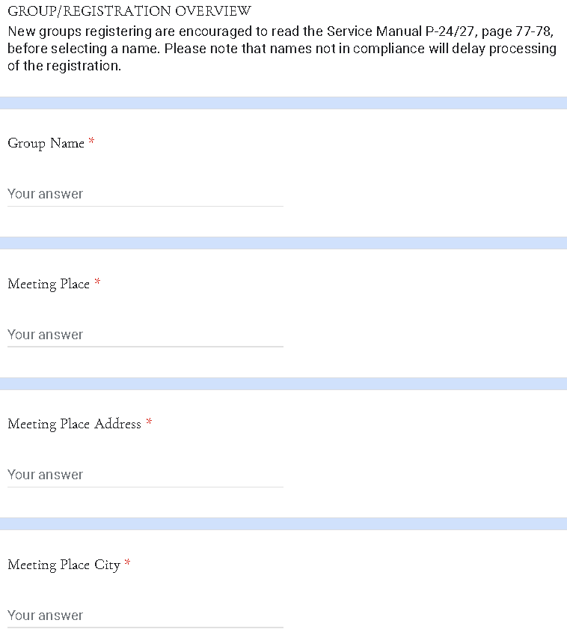

Slide 12
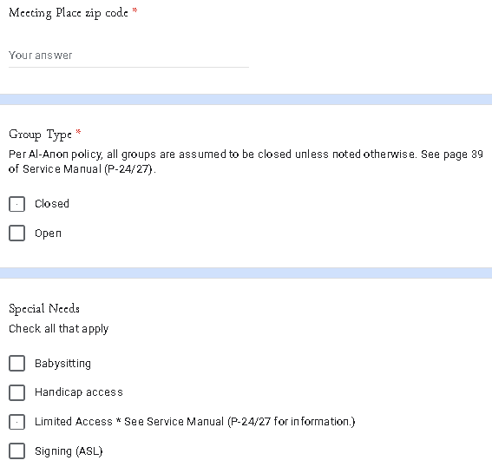
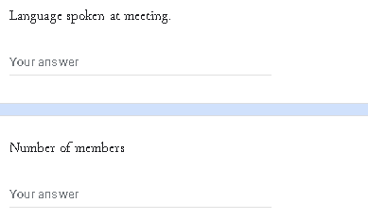

Slide 13
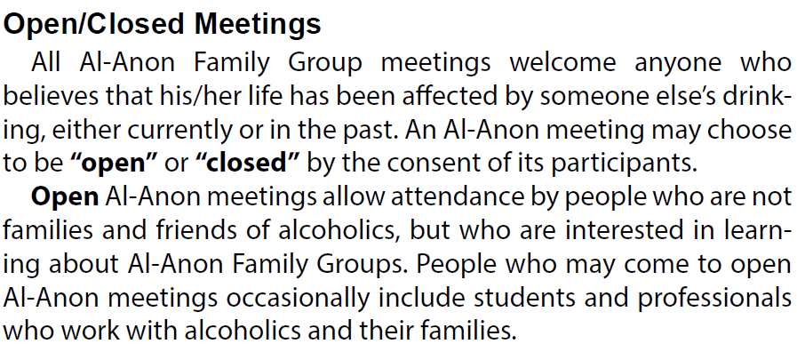

Slide 14
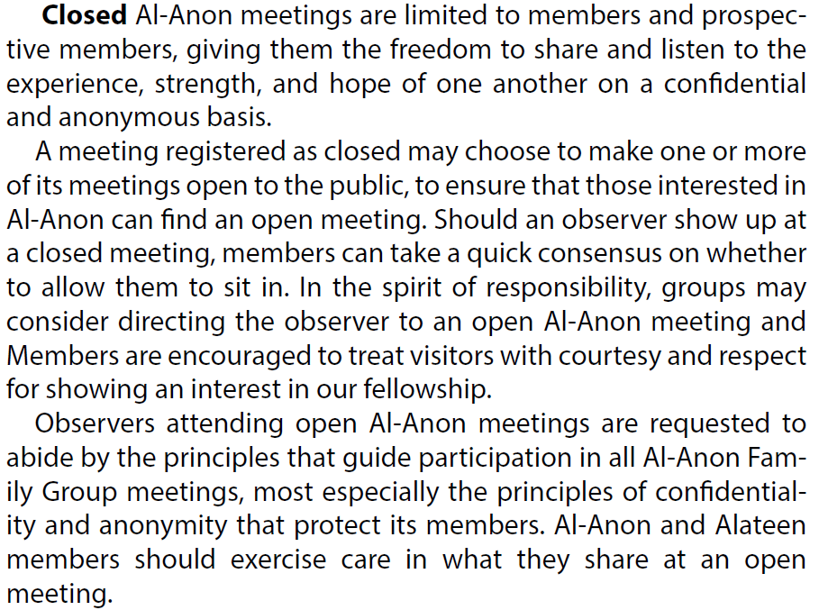

Slide 15
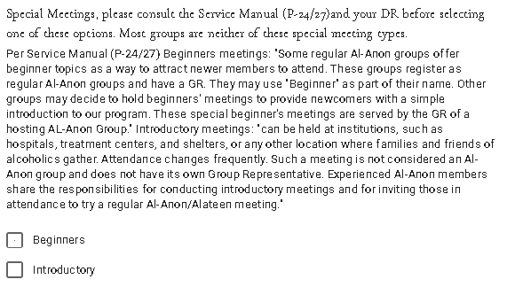
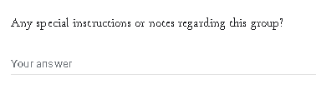

Slide 16
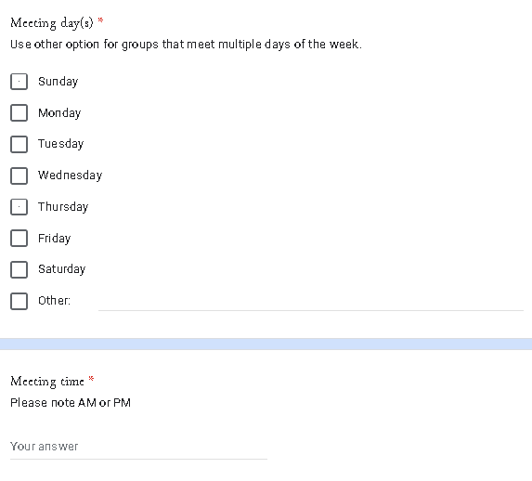

Slide 17
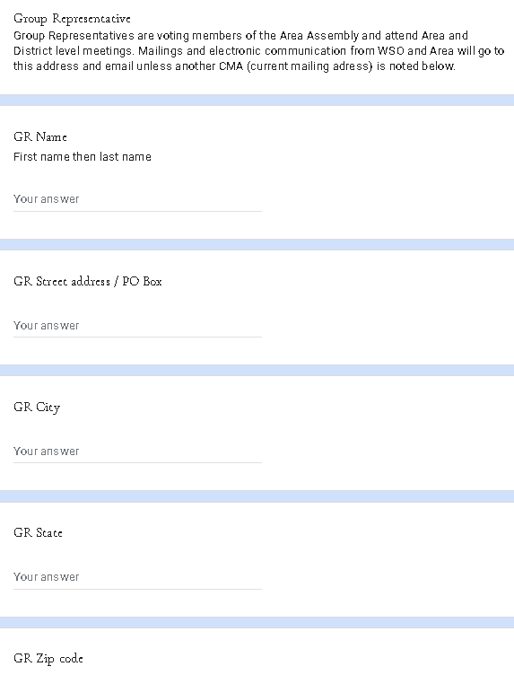
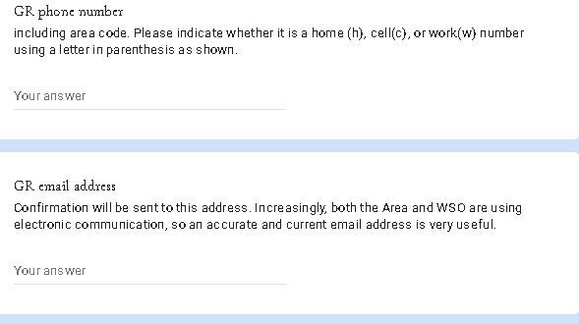

Slide 18
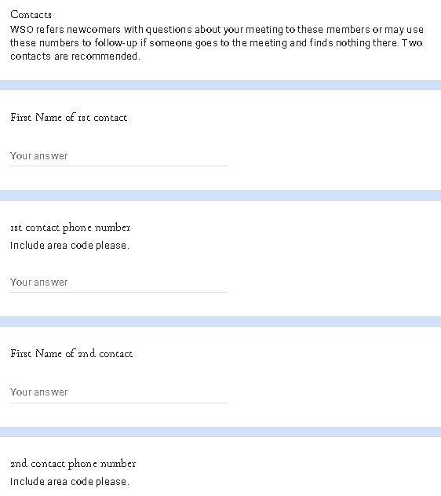

Slide 19
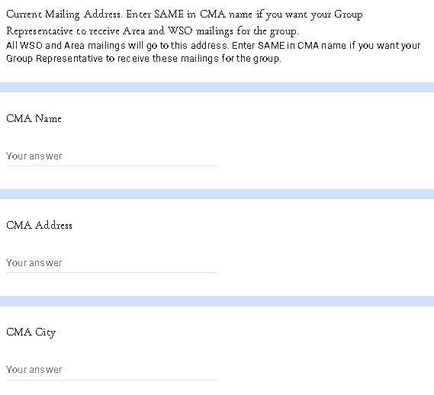
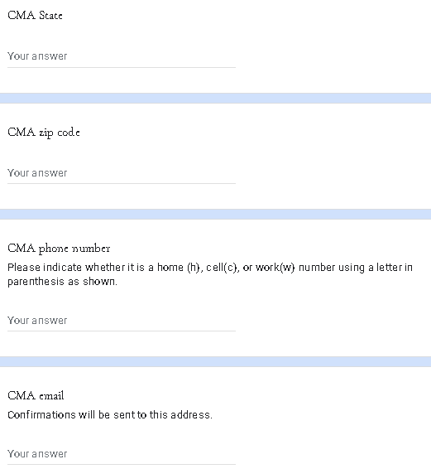

Slide 20
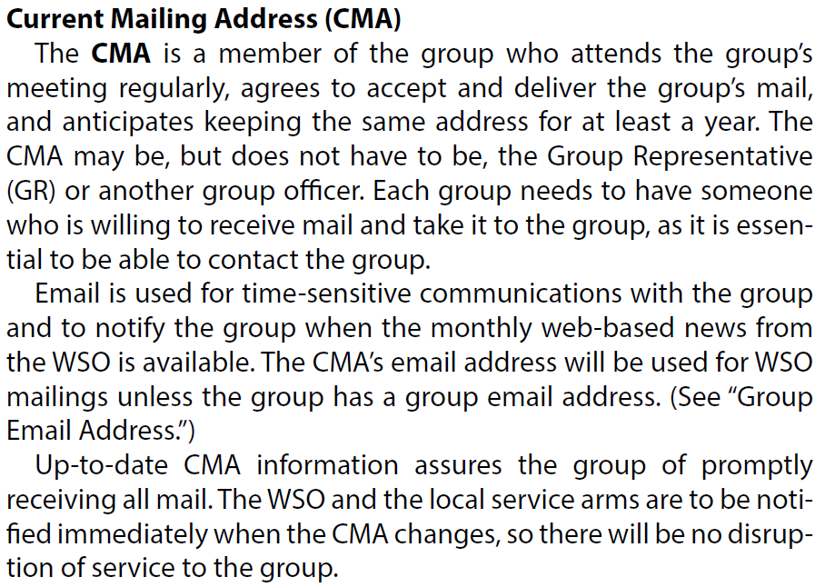

Slide 21
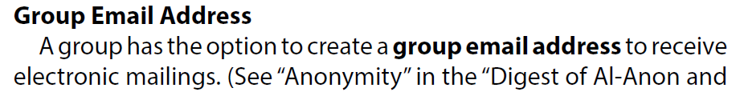
Electronic Meeting Workaround Until Area Policy Established
Temporary electronic meeting. Submit request on the GR change form with meeting link, ID, and password.

Slide 22
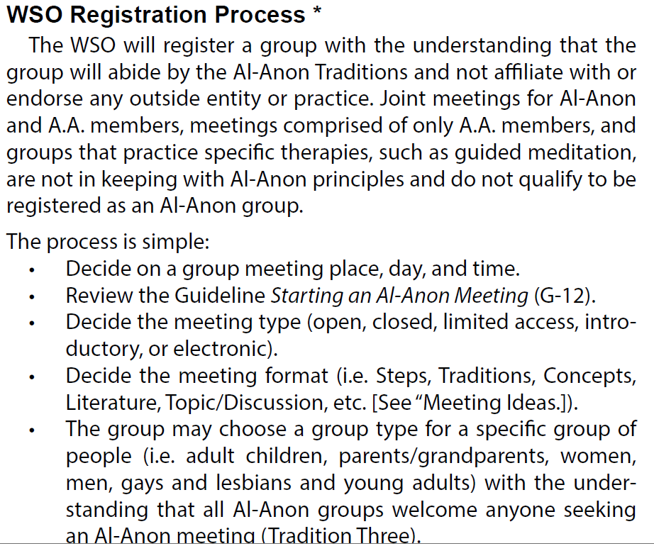

Slide 23
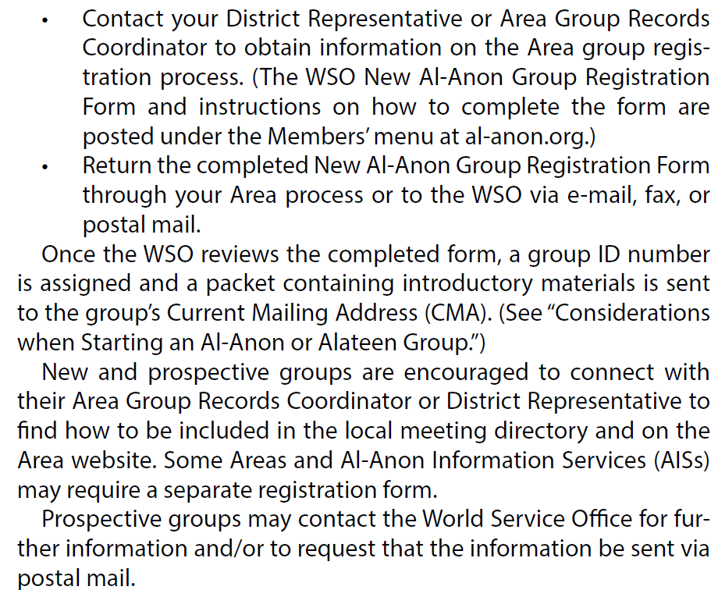

Slide 24
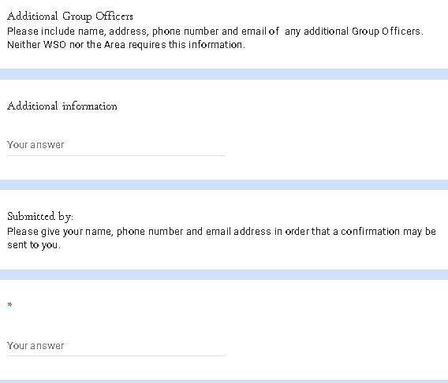
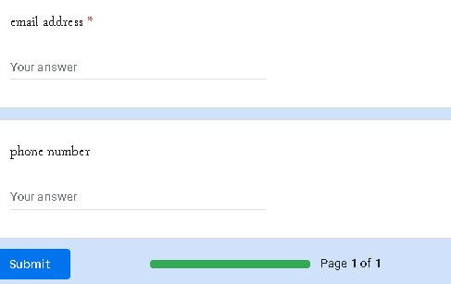

Slide 25
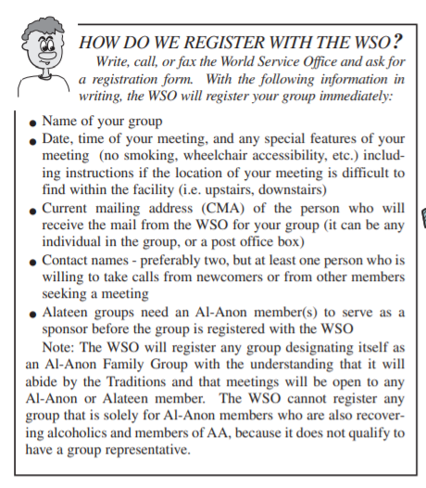
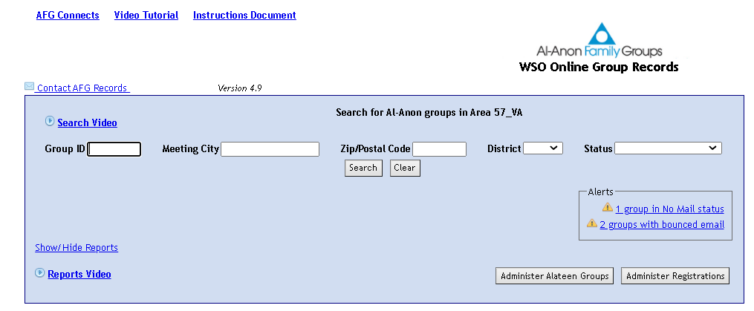
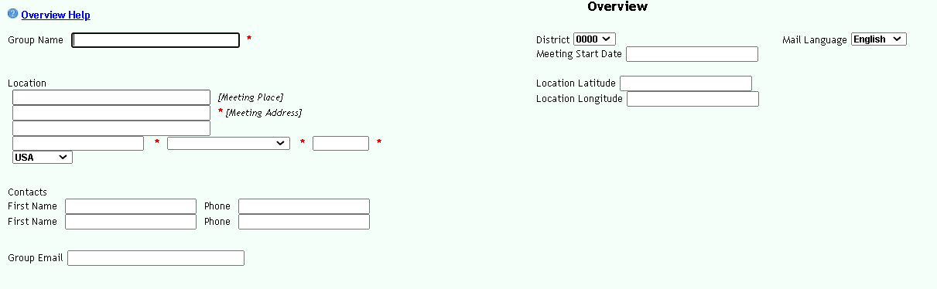
OR FILL OUT THE GROUP RECORDS CHANGE FORM, TINY URL, AND THE GRC WILL REGISTER YOUR GROUP!

Slide 26
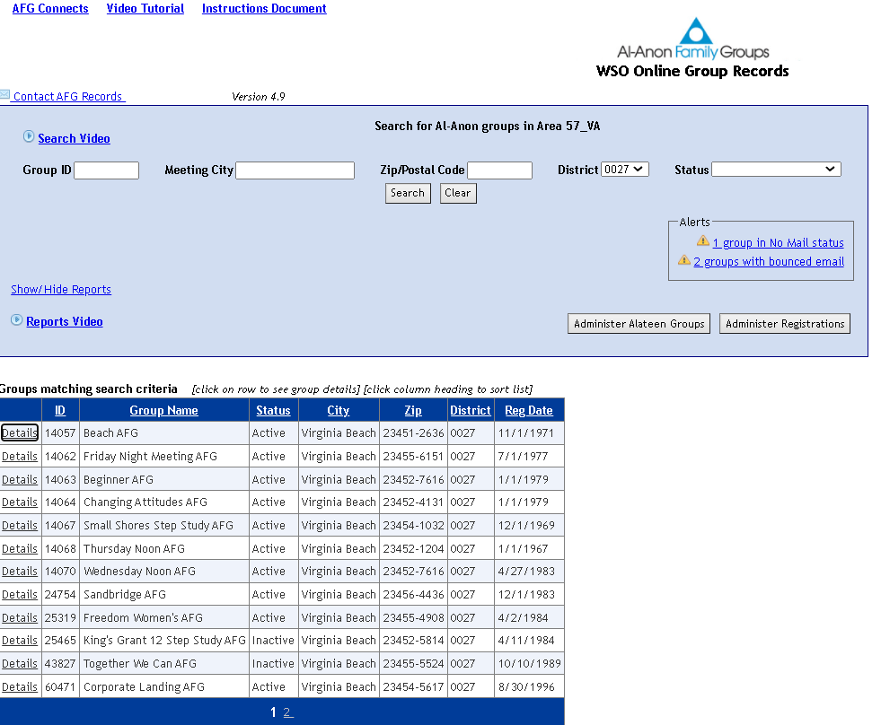
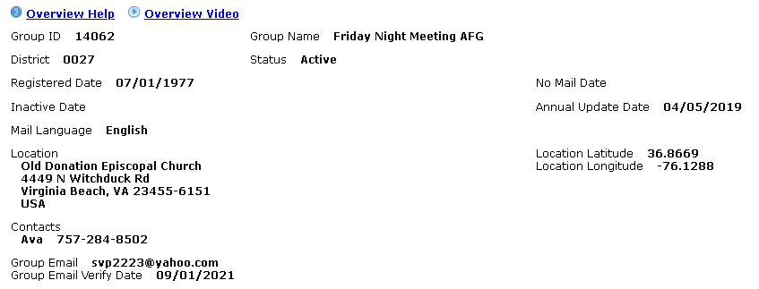
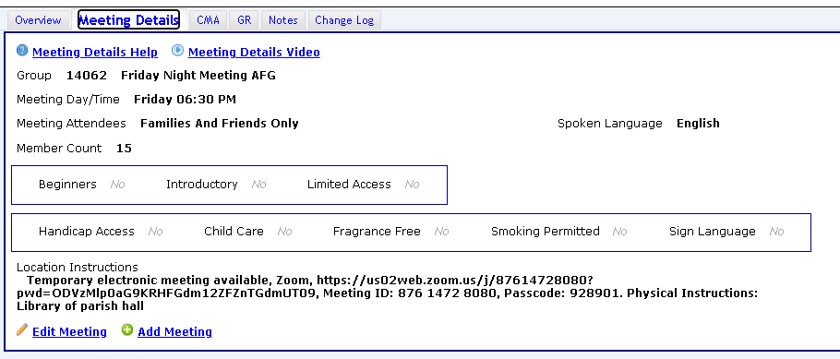

Slide 27
Area Group Records Database
Website Coordinatorsyncs with the Area Website
Beach AFG | 27 | Families And Friends Only | Galilee Episcopal Church | 3928 Pacific Ave | Virginia Beach | VA | 23451-2636 | Saturday | 7:00 PM | Alanon,Temporarily suspended |  | English |  | Temporarily suspended due to COVID.
Changing Attitudes AFG | 27 | Families And Friends Only | St Francis Episcopal Church | 509 S Rosemont Rd | Virginia Beach | VA | 23452-4131 | Thursday | 8:00 PM | Alanon,Virtual,Telephone |  | English |  | Phone meeting; dial in with phone number 605-562-8401; access code is 9934966.
Friday Night Meeting AFG | 27 | Families And Friends Only | Old Donation Episcopal Church | 4449 N Witchduck Rd | Virginia Beach | VA | 23455-6151 | Friday | 6:30 PM | Alanon,Virtual |  | English |  | Meeting online at Zoom, https://us02web.zoom.us/j/87614728080?pwd=ODVzMlp0aG9KRHFGdm12ZFZnTGdmUT09, Meeting ID: 876 1472 8080, Passcode: 928901; Library of parish hall
Thursday Noon AFG | 27 | Families And Friends Only | Thalia Lynn Baptist Church | 4392 Virginia Beach Blvd | Virginia Beach | VA | 23452-1204 | Thursday | 12:00 PM | Alanon,Virtual |  | English |  | Online meeting on Zoom at https://us02web.zoom.us/j/88120219298?pwd=bzdxWUZtQS9mYjF2ZjVTL0xhS2crQT09; Meeting ID: 881 2021 9298; Passcode: 114842; when in person meetings resume, Church is next door to Princess Anne H S; go to front door to be buzzed in
Freedom Women's AFG | 27 | Families And Friends Only | Bayside Presbyterian Church | 1400 Ewell Rd | Virginia Beach | VA | 23455-4908 | Sunday | 7:00 PM | Alanon,Face to face |  | English |  | Face to face meeting; contact group email with questions at freedomwomenafg@yahoo.com.

Slide 28
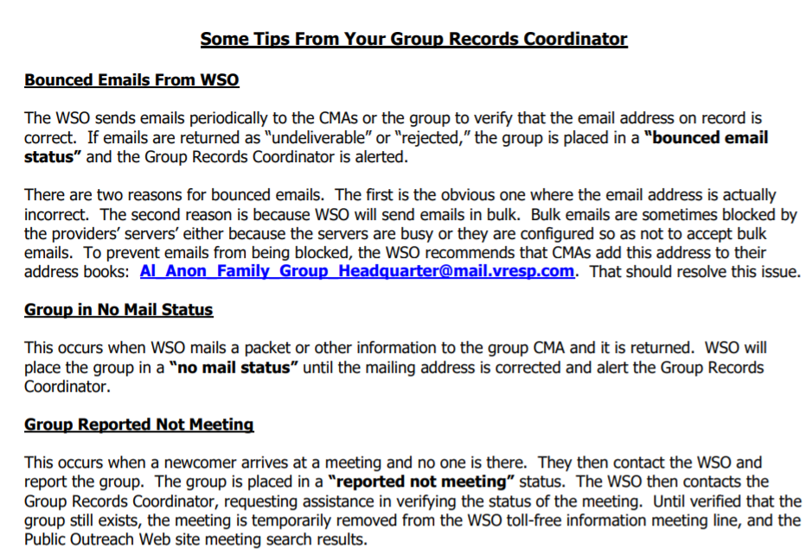
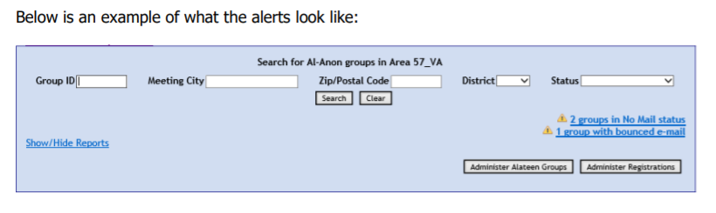

Slide 29
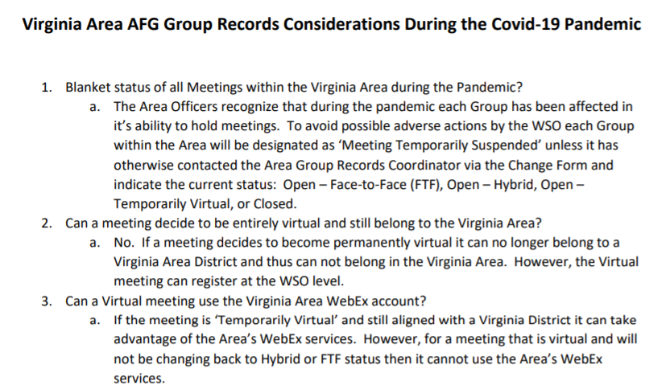

Slide 30

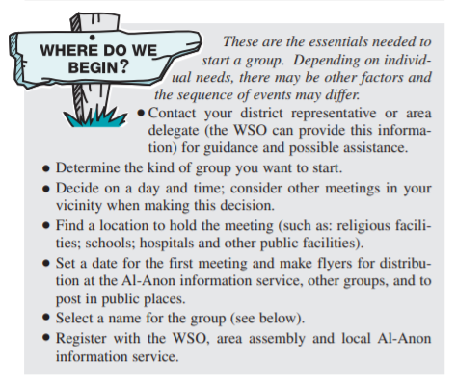
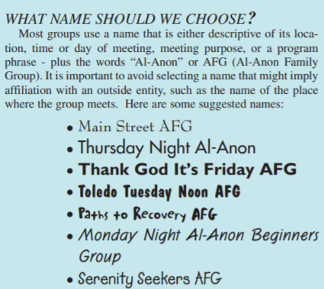

Slide 31

Hopefully not you now???

Slide 32

When tempted by Minion wisdom
Contact Your Friendly Group Records Coordinator

Slide 33
But Seriously Don’t Hesitate to Reach Out Until the New GRC Arrives; text, email, phone call work.
Chris B. 703-389-1405
cbnp15@Verizon.net

Slide 34
THANK YOU FOR YOUR ATTENTION!
ALL THE BEST WITH THE NEW PANEL!
QUESTIONS?

