Slide 1
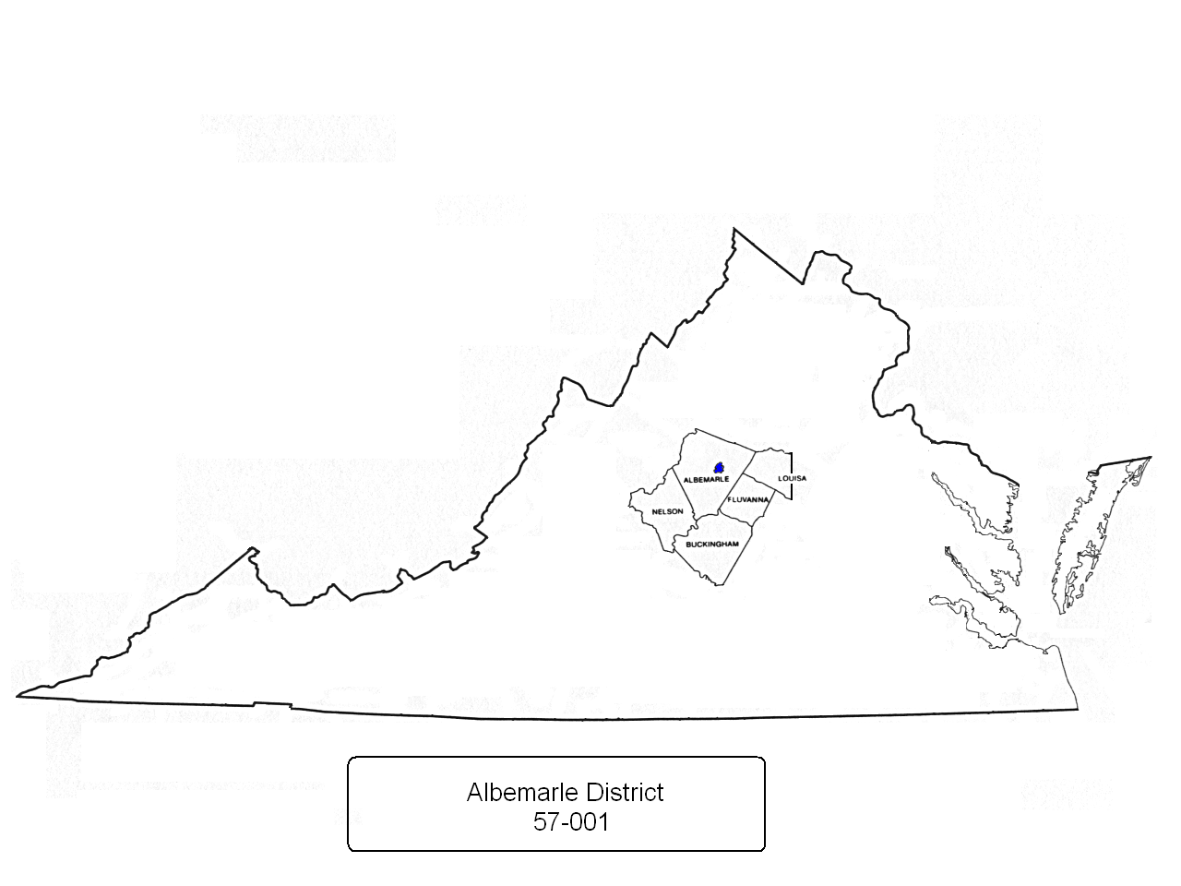
Counties of Albemarle (to include the City of Charlottesville), Buckingham, Fluvanna, Nelson and that portion of Louisa County generally west of State Routes 208 and 669 but not including the town of Louisa.

Slide 2
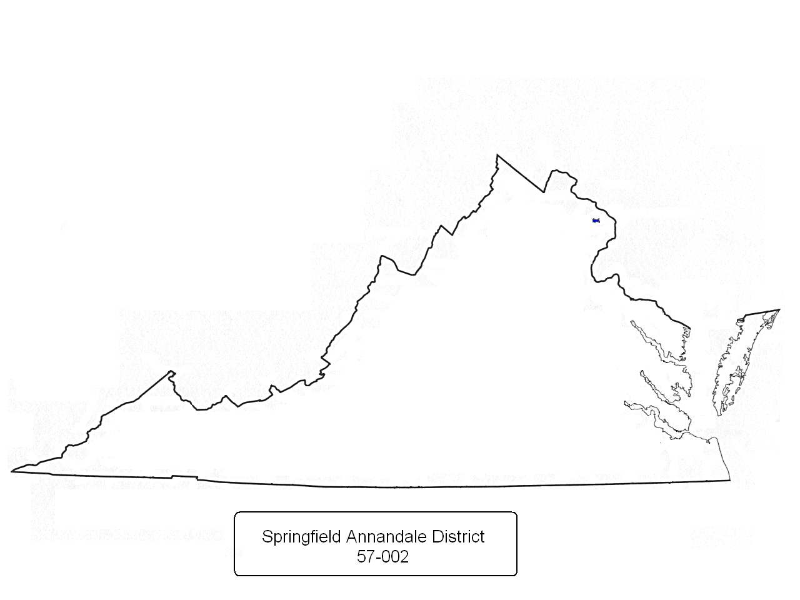
Residential areas within the confines of Fairfax County known as Springfield and Annandale

Slide 3
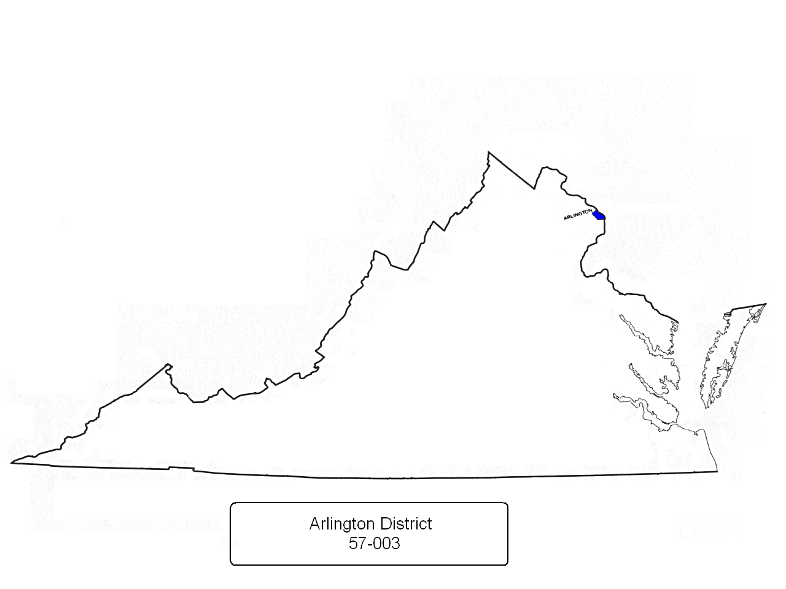
County of Arlington

Slide 4
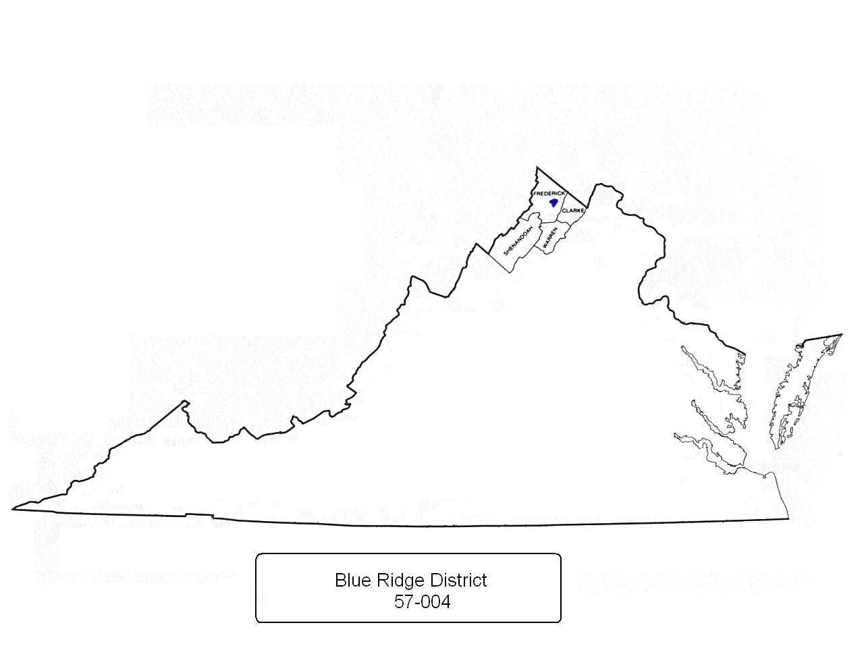
Counties of Clark, Frederick (to include the town of Winchester), Shenandoah and Warren

Slide 5
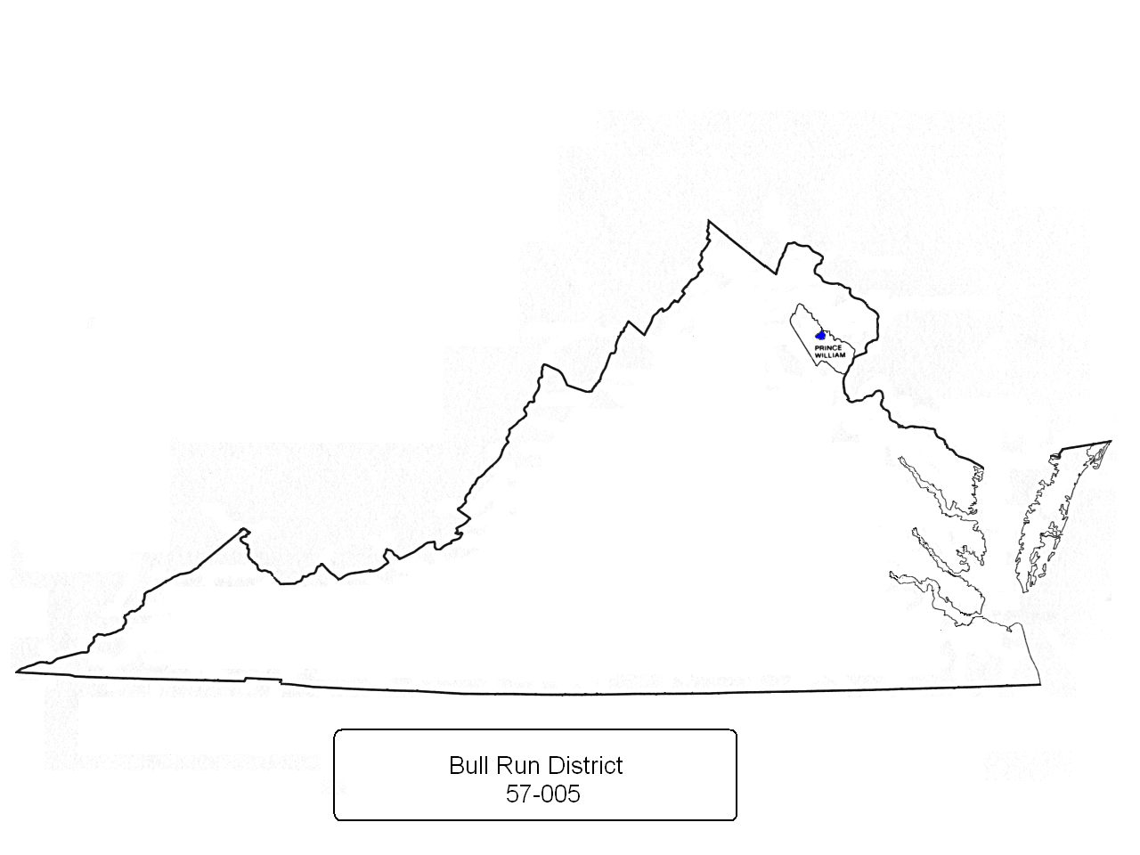
Prince William County to include the city of Woodbridge

Slide 6
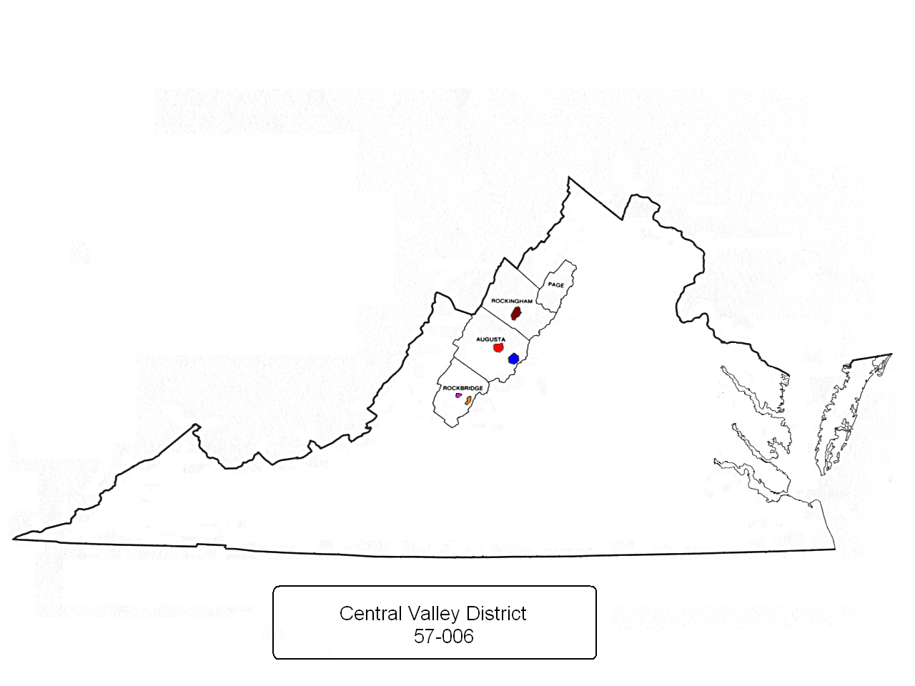
Counties of Augusta (to include the cities of Staunton and Waynesboro), Page, Rockbridge (to include the city of Lexington and the town of Buena Vista) and Rockingham (to include the city of Harrisonburg)

Slide 7
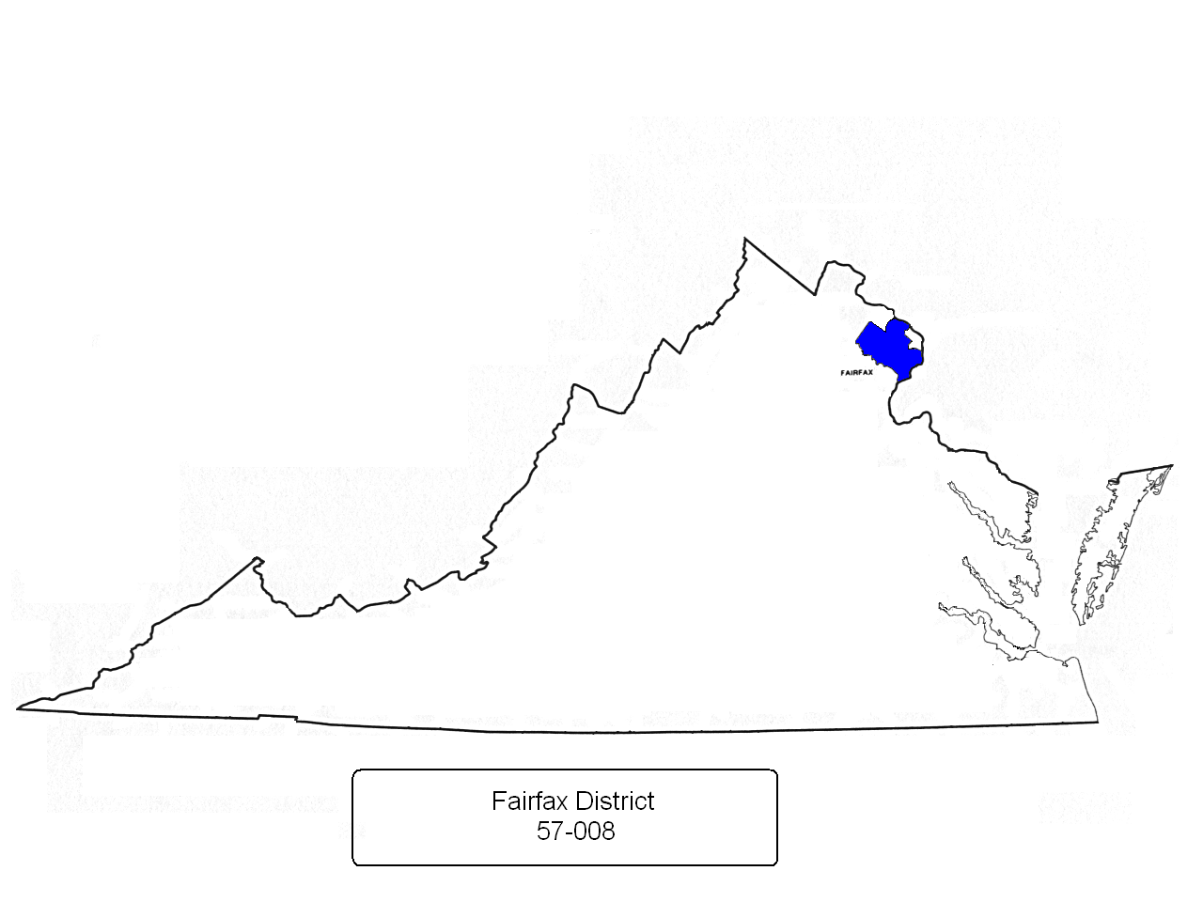
County of Fairfax , excluding Al-Anon Districts 57-002 (Springfield Annandale) and 57-009 (Falls Church-McLean) and that portion of the county generally south of the Potomac River, west of Interstate 495 (Beltway) and north of State Route 267 (Dulles Access Road)

Slide 8
Cities of Falls Church , McLean, Oakton and Vienna (all within the boundaries of Fairfax County)

Slide 9
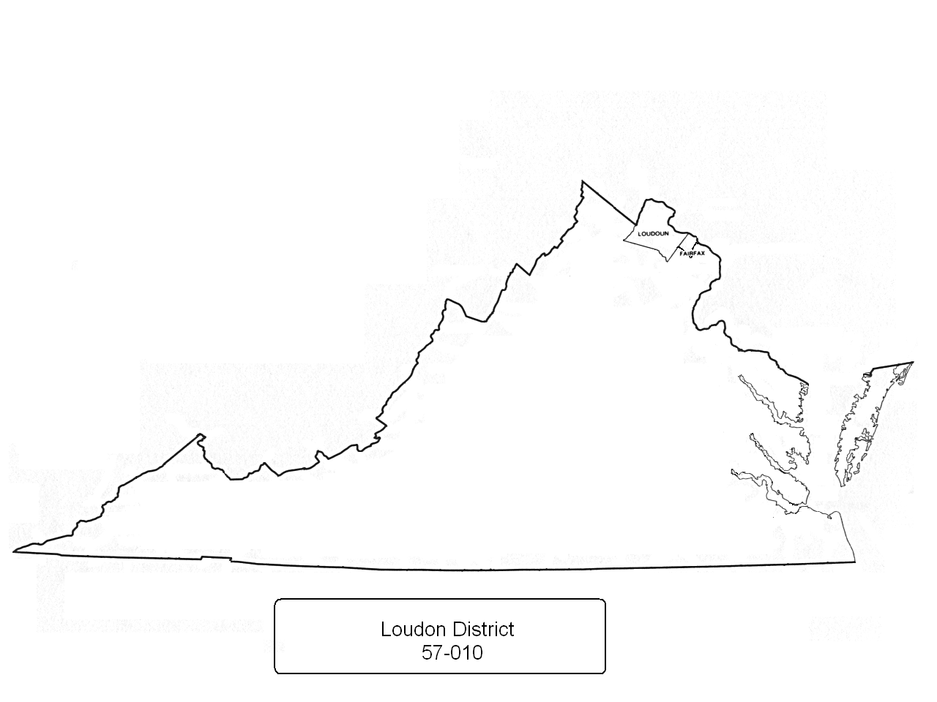
Loudon County and that portion of Fairfax County generally south of the Potomac River, west of Interstate 495 (Beltway) and north of State Route 267 (Dulles Access Road) to include the residential areas of Great Falls, Herndon, Reston and Leesburg
Current as of November 3, 2008

Slide 10
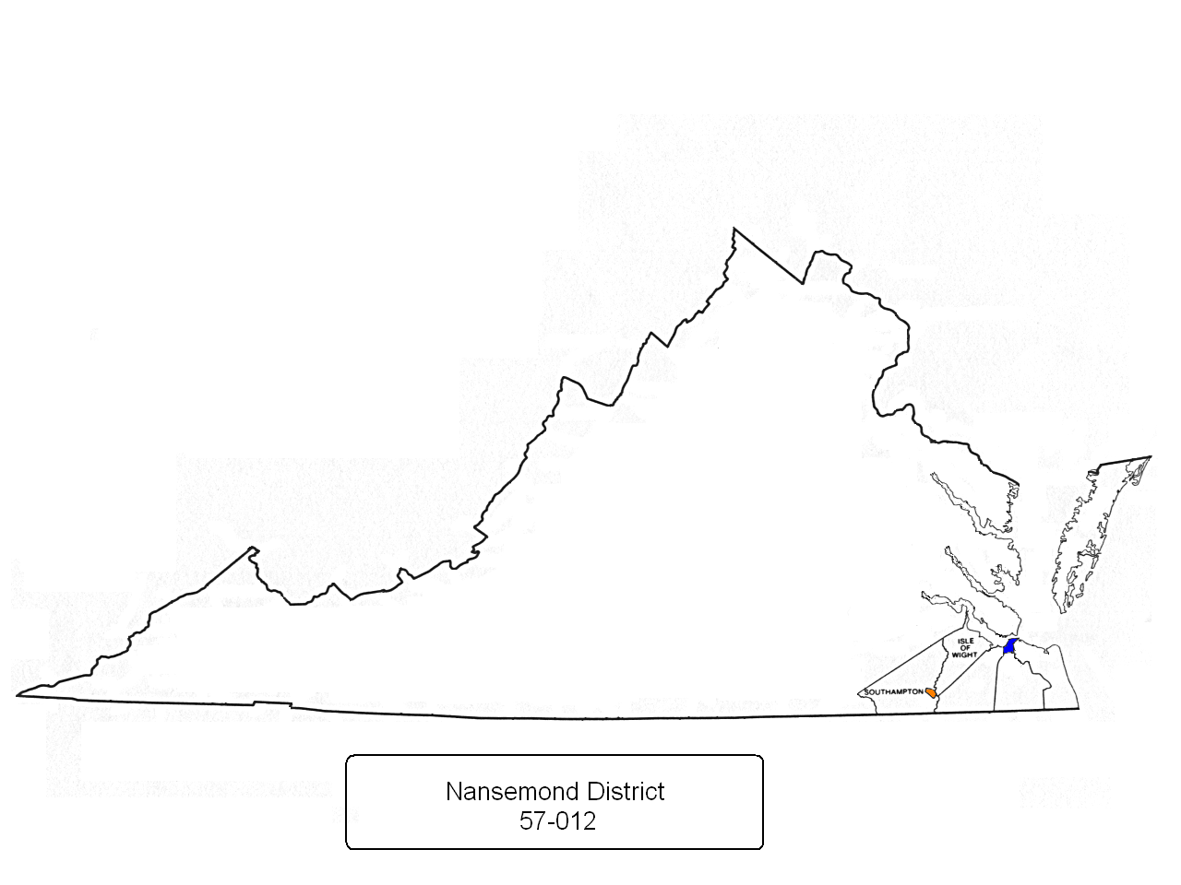
Counties of Chesapeake, Isle of Wight, Southampton, Suffolk and the Cities of Franklin and Portsmouth
Suffolk
Chesa-
peake

Slide 11
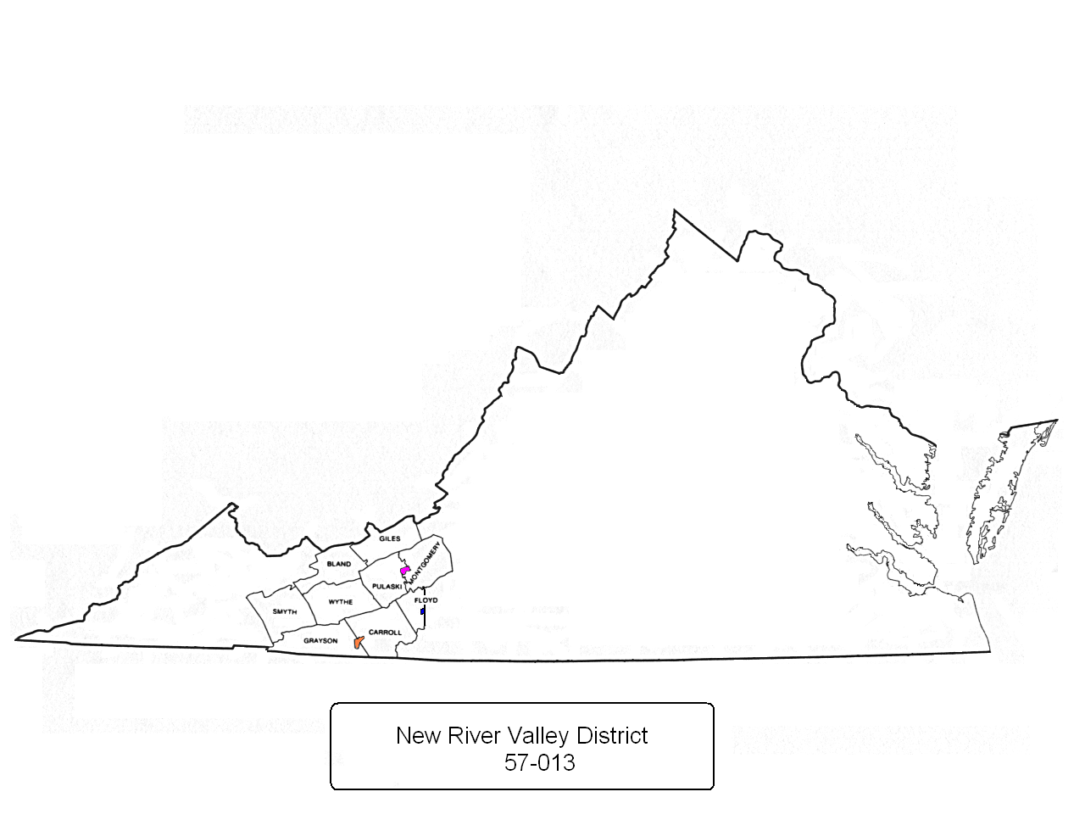
Counties of Bland, Carroll, Giles, Grayson, Montgomery, Pulaski, Smyth, Wythe and that portion of Floyd County generally west of State Route 8 to include the town of Floyd, and the towns of Blacksburg and Galax

Slide 12
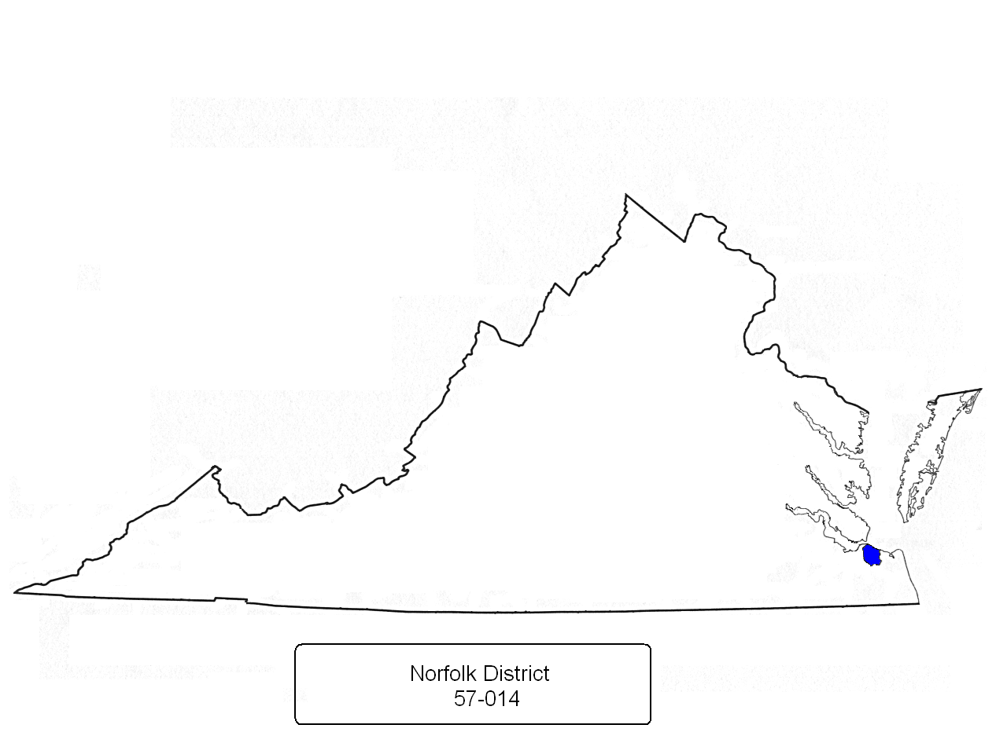
City of Norfolk

Slide 13
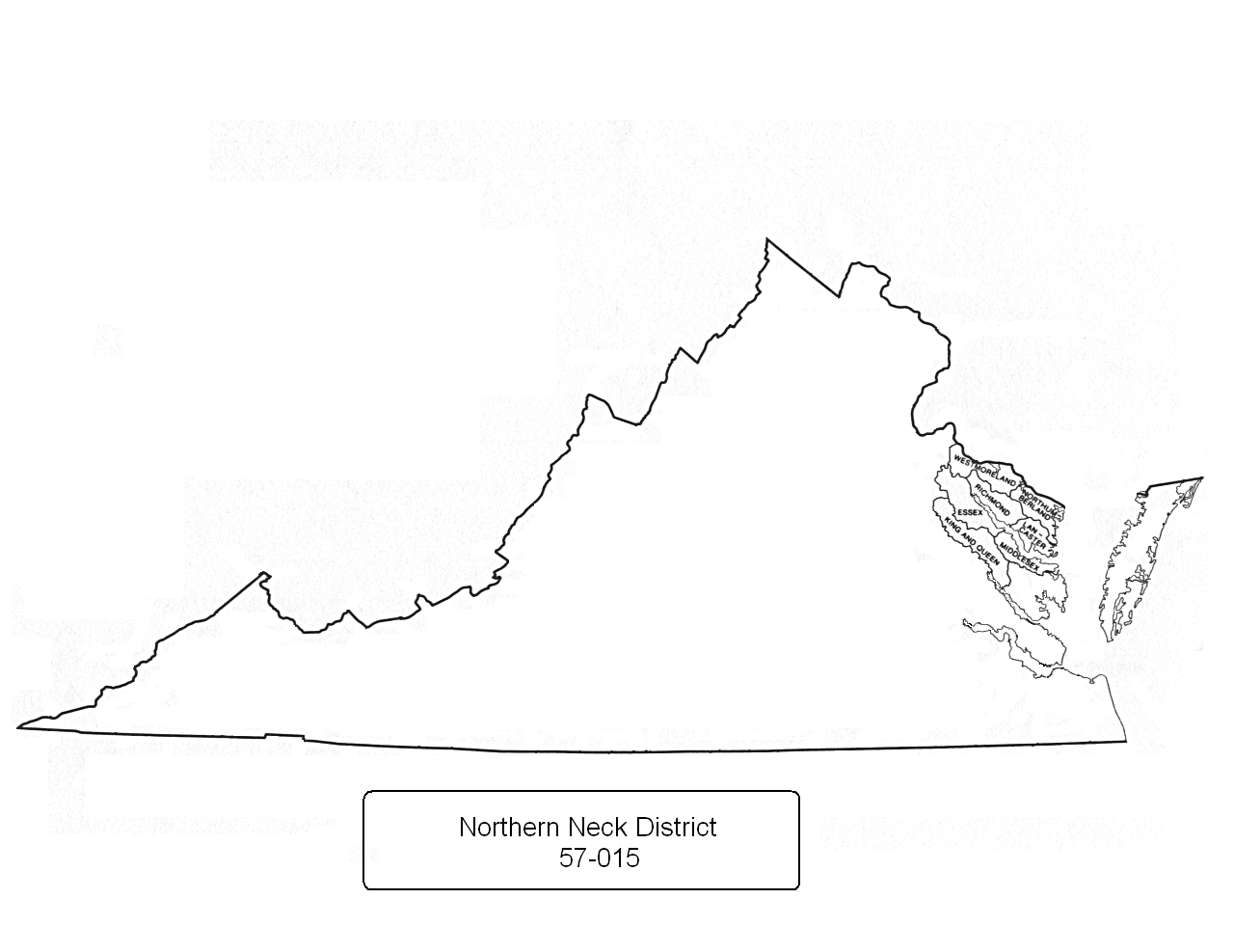
Counties of Essex, King and Queen, Lancaster, Middlesex, Northumberland, Richmond and Westmoreland

Slide 14
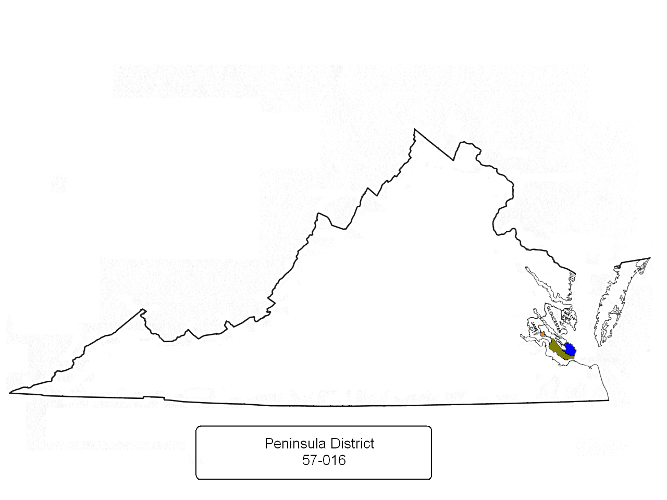
Counties of Gloucester, James City, Mathews, York and the Cities of Hampton, Newport News and Williamsburg
Current as of November 3, 2008

Slide 15
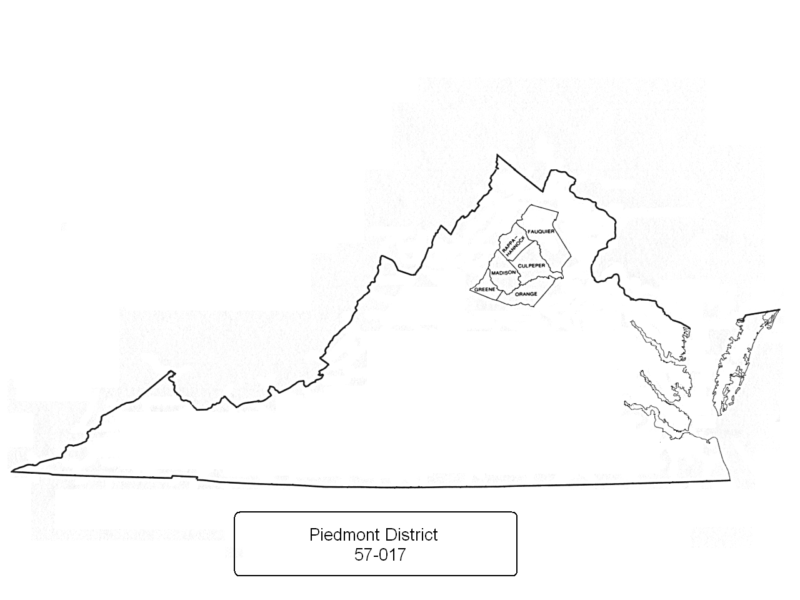
Counties of Culpeper, Fauquier, Greene, Madison, Orange and Rappahannock

Slide 16
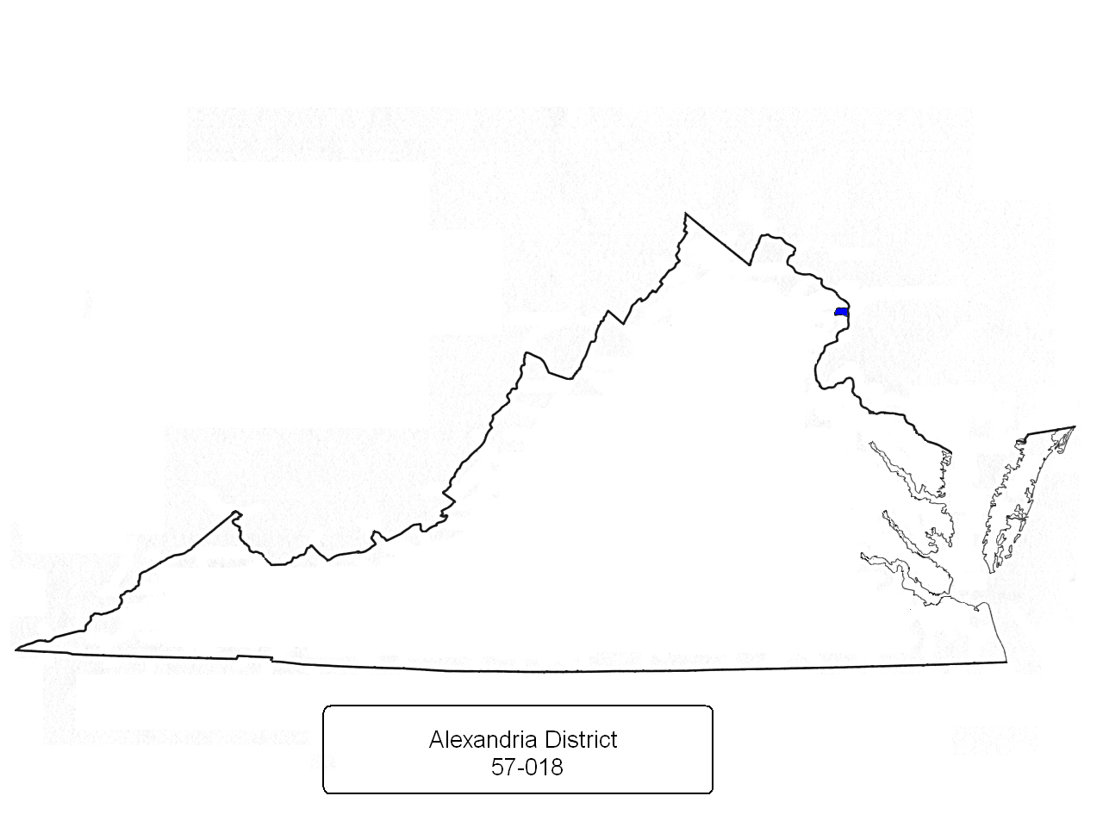
City of Alexandria

Slide 17
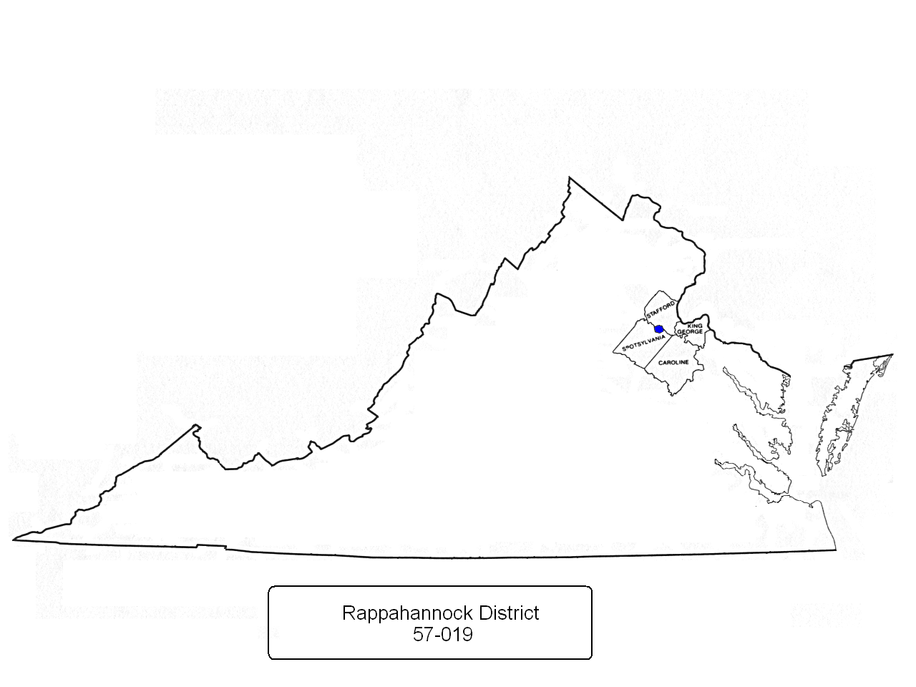
Counties of Caroline, King George, Spotsylvania, Stafford and the City of Fredericksburg

Slide 18
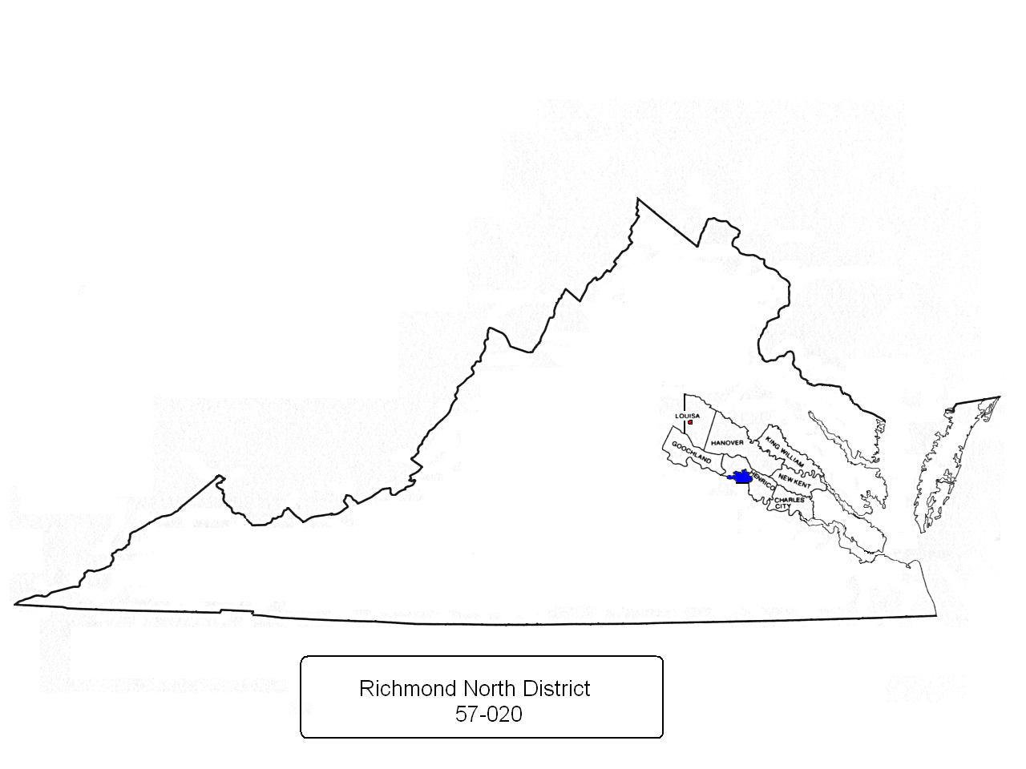
Counties of Charles City, Goochland, Hanover, Henrico, King William, New Kent, that portion of Louisa County generally east of Virginia State Routes 208 and 669 including the town of Louisa, and that portion of the City of Richmond generally north of the James River

Slide 19
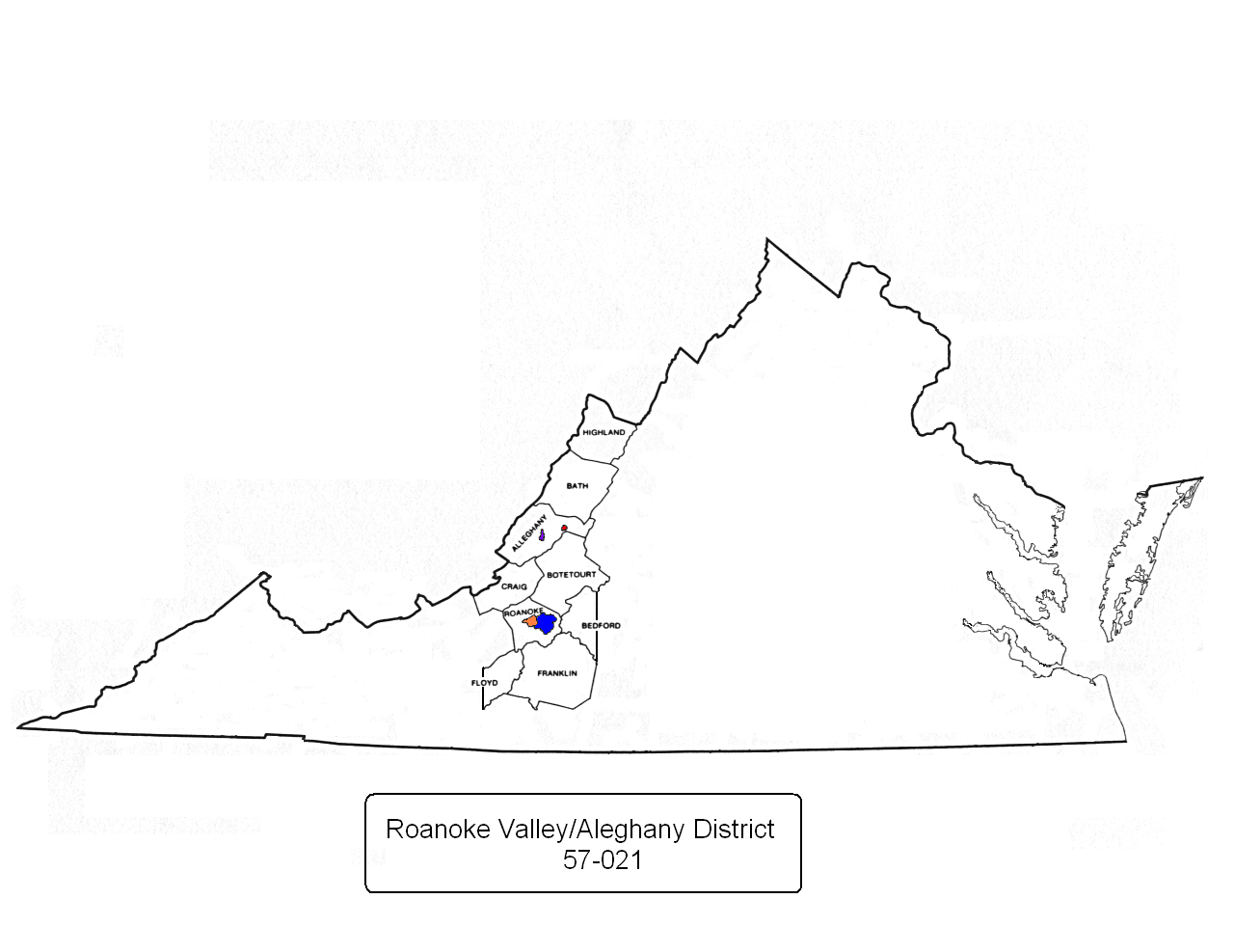
Counties of Alleghany, Bath, Botetourt, Craig, Franklin, Highland, Roanoke, that portion of Bedford County generally west of State Route 122 (but not including the town of Bedford) and that portion of Floyd County generally east of State Route 8 (but not including the town of Floyd) and the cities of Roanoke, Salem and the towns of Covington and Clifton Forge

Slide 20
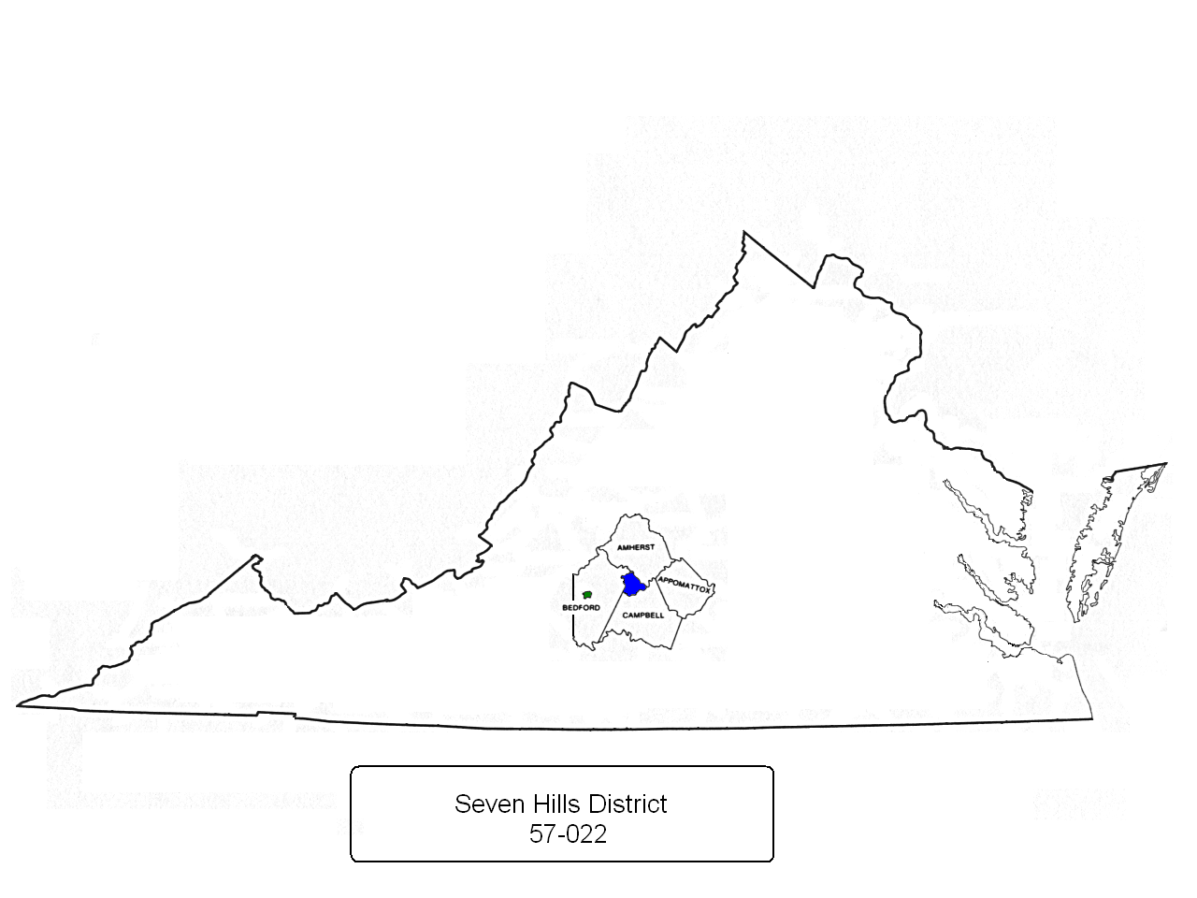
Counties of Amherst, Appomatox, that portion of the county of Bedford generally east of Route 122 to include the city of Bedford , Campbell county and the city of Lynchburg

Slide 21
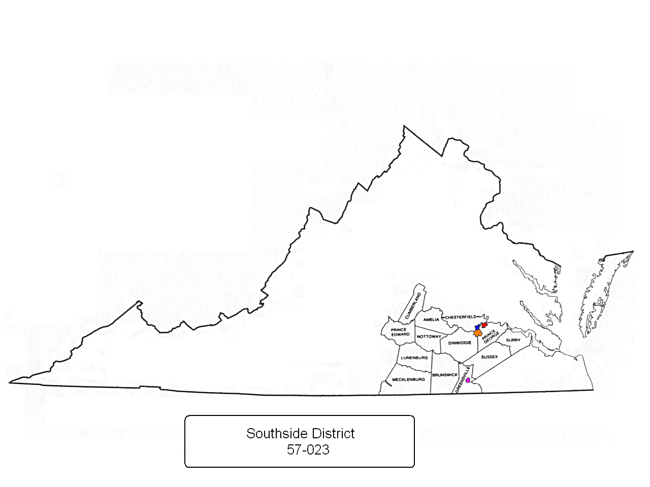
Counties of Amelia, Brunswick, Cumberland, Dinwiddie, Greensville, Lunenburg, Mecklenburg, Nottoway, Prince Edward, Prince George, Surry, Sussex and that portion of Chesterfield County generally south of Swift Creek and the cities of Colonial Heights, Hopewell, Emporia and Petersburg

Slide 22
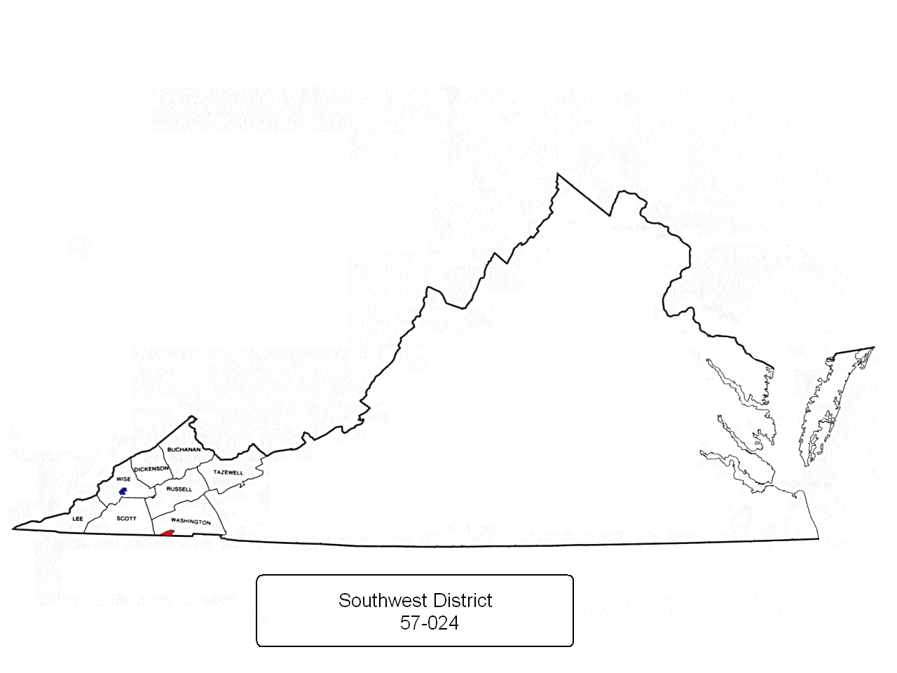
Counties of Buchannan, Dickenson, Lee, Russell, Scott, Tazewell, Washington, including the city of Bristol, VA, and Wise, to include the town of Big Stone Gap

Slide 23
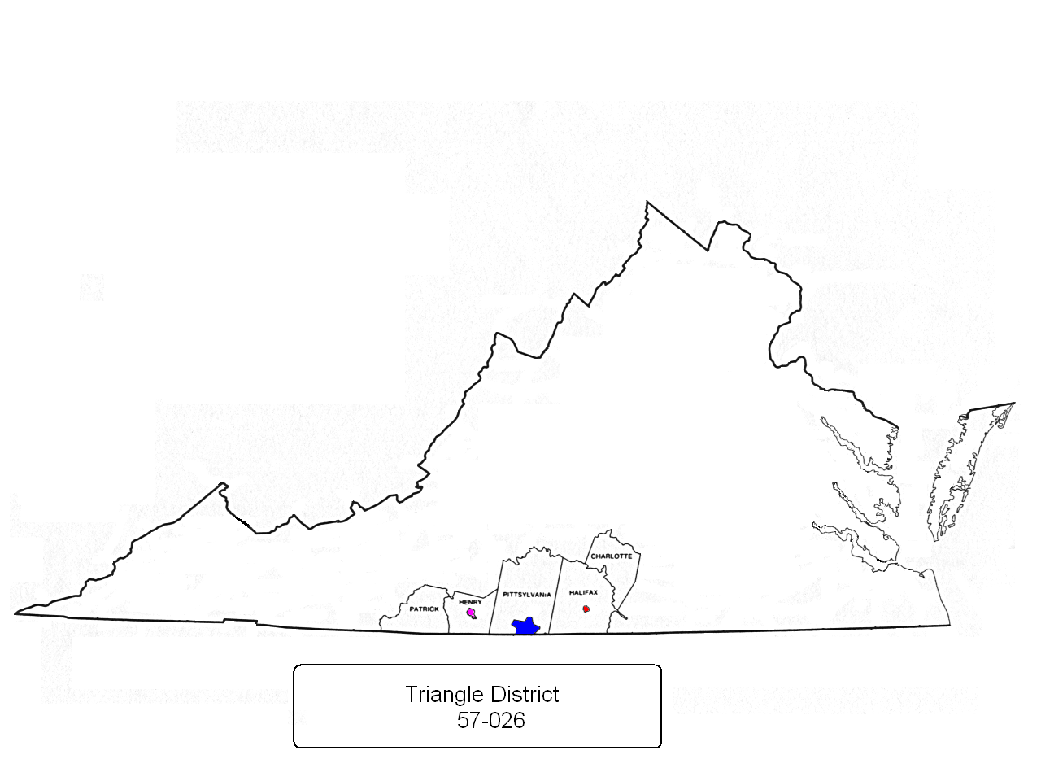
Counties of Charlotte, Halifax (to include the town of South Boston), Henry (to include the city of Martinsville), Patrick and Pittsylvania (to include the city of Danville)

Slide 24
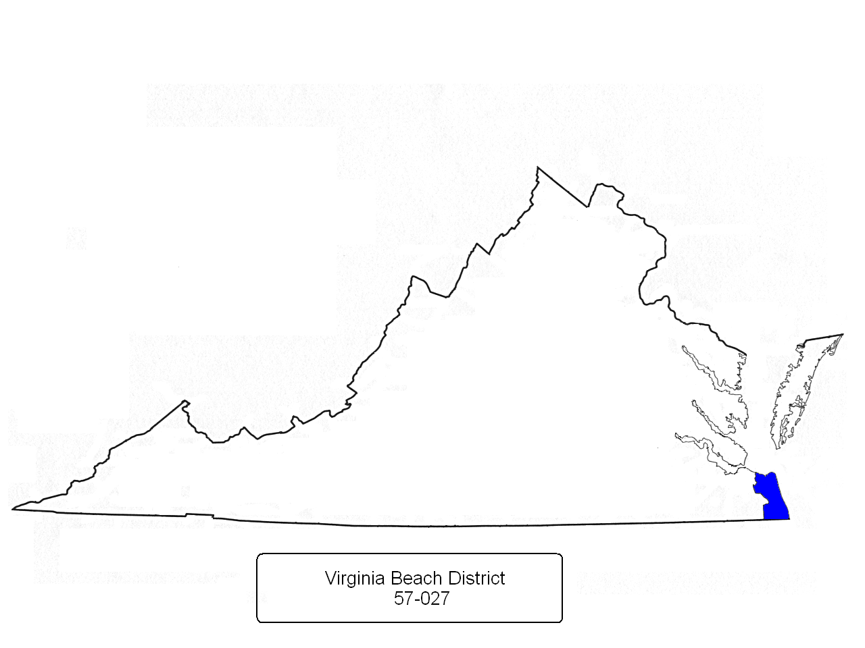
City of Virginia Beach

Slide 25
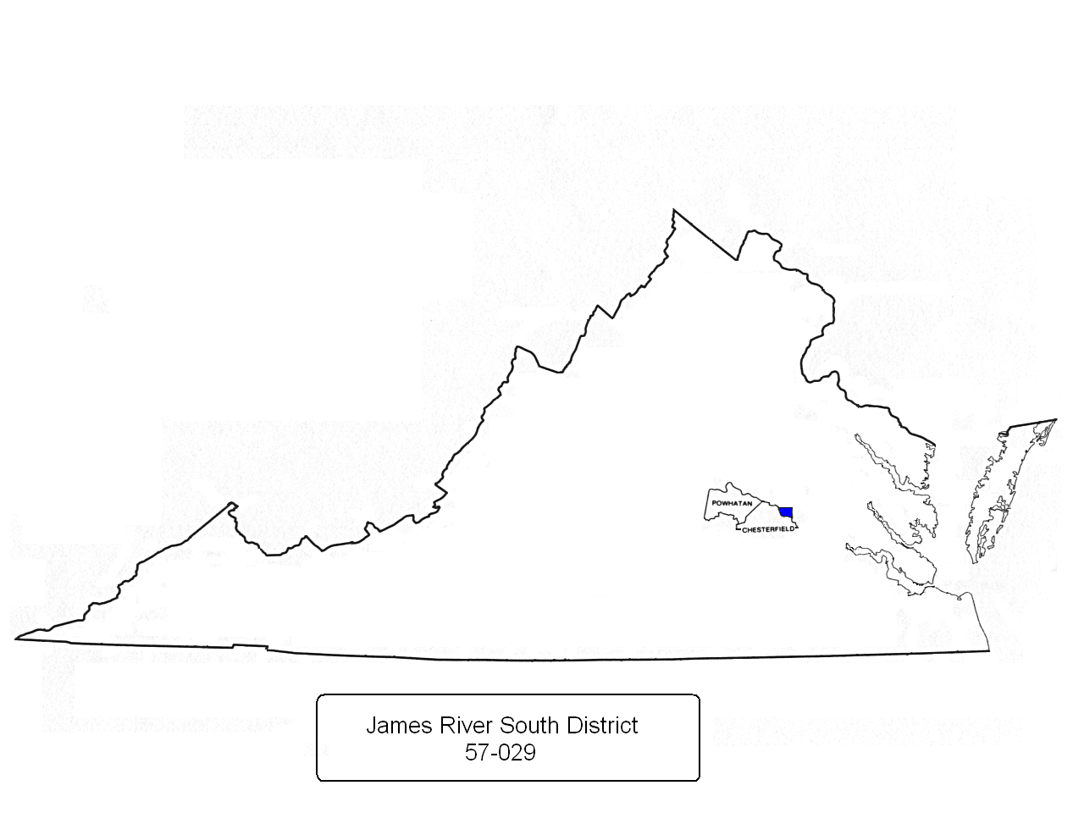
Counties of Powhatan, that portion of Chesterfield county generally north of Swift Creek, and that portion of the city of Richmond generally south of the James River

